Slide 1

Battery Management systems: Cell/Battery Pack Modelling and SOC Estimation using Kalman Filter

Slide 2
Disclaimer
Images in the theory section are taken from Coursera Specialization on BMS without any intention of infringement
Some images in theory part are from Mathworks
All the models are created from scratch and simulation results presented are novel.

Slide 3
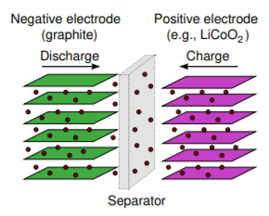
Understanding Li-ion cells
The chemistry which makes Li-ion cells different from other redox reaction cells is the process of intercalation followed in the cell.
Lithium is stored in the electrodes much like water is stored in a sponge. Intercalation involves insertion of lithium ions into crystalline lattice of host electrode without changing its crystal structure.
Li is stored in the electrodes, and Li+ moves through the electrolyte
Li+ enters an electrode, becoming Li when an electron is available; Li exits an electrode and becomes Li+ when it can give up an electron
Electrodes have two key properties:
Open crystal structures, allowing insertion or extraction of lithium ions in the vacant spaces.
Ability to accept compensating electrons.

Slide 4
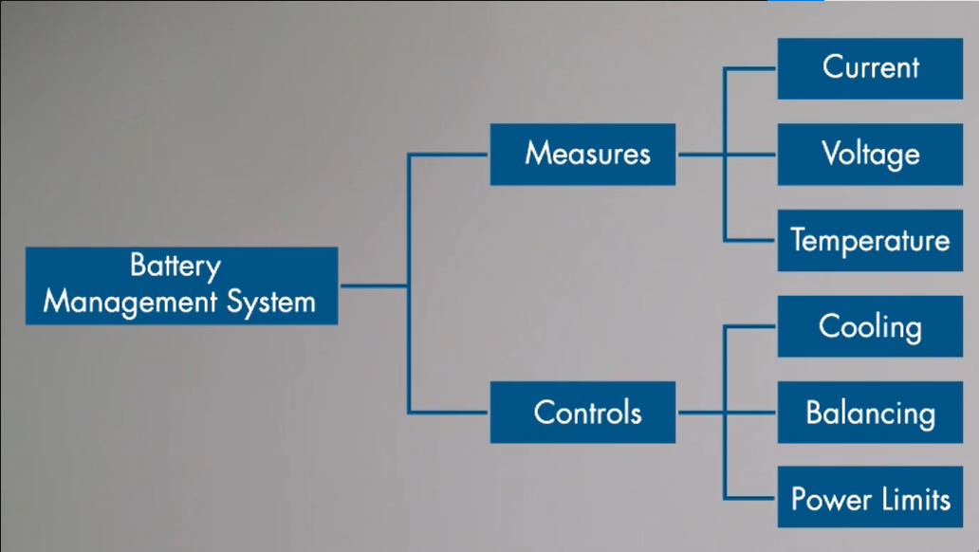
Battery management system
Li-ion chemistry requires careful monitoring and control of SOC of respective cell to ensure safety of operation, good performance and acceptable durability this functions are tasked to BMS.
A BMS comprises purpose-built electronics plus custom designed algorithms (computer methods).Thus, it is an embedded system.
The primary functions of a BMS are to:
Protect human safety of device’s operator: Detect unsafe operating conditions and respond
Protect cells of battery from damage in abuse/failure cases
Prolong life of battery (normal operating cases)
Maintain battery in a state in which it can fulfill its functional design requirements
Inform the application controller how to make the best use of the pack right now (e.g., by providing power limits), control charger, etc.

Slide 5
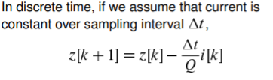
Making of equivalent circuit cell
Starting with simplest possible model i.e., ideal voltage source where in this model v(t) = OCV. Voltage is not the function of current, also not a function of past usage and assuming the voltage is constant for the period.
Including the SOC and capacity phenomena can improve model as on full charge the OCV is high than when it is discharged. Also to define total capacity Q (mAh/Ah) to be total amount of charge removed when discharging from z =100% to z = 0%.

Slide 6
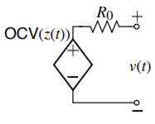
How do we measure voltage polarization?
The above question can be answered using Rint model. Polarization refers to any departure of the cell’s terminal voltage away from OCV due to a passage of current For example, cell’s voltage drops when it is under load.
This can be modeled, in part, as a resistance in series with the ideal voltage source (the “Rint” model). [v(t) = OCV(z(t)) – R0.i(t)
v(t) > OCV(z(t)) on charge.
v(t) < OCV(z(t)) on discharge.
Power dissipated by R0 as heat : energy efficiency imperfect

Slide 7
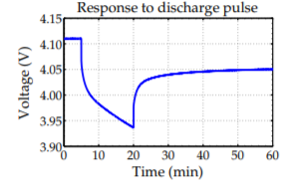
Diffusion voltage
“Rint” model suffices for simple electronics designs, but not for advanced consumer electronics and xEV applications.
i(t).R0 models instantaneous response to a change in input current.
In practice, we also observe dynamic (non-instantaneous) response to a current step Similarly, when cell rests, voltage doesn’t immediately return to OCV: relaxes gradually.
Caused by slow diffusion processes in the cell, so this slowly-changing voltage is referred as a diffusion voltage.

Slide 8
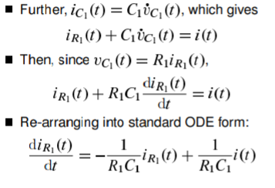
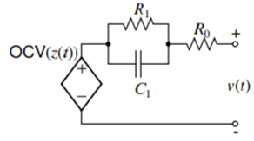
Thevenin model for diffusion measure
Diffusion voltages can be closely approximated in a circuit using one or more parallel resistor-capacitor sub-circuits.
The cell Thevenin model is : v(t) = OCV(z(t))-vc1(t)-i(t)R0, where vc1 = R1I(t).

Slide 9
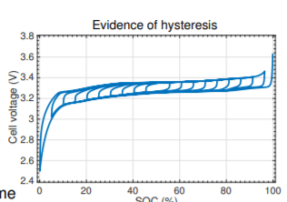
Hysteresis Voltage
If a cell is allowed to rest long enough, diffusion voltages decay to zero, so model voltage decays to OCV. In a real cell, this doesn’t happen. For every SOC, we find a range of possible stable “OCV” values.
Ignoring it causes large prediction errors. Note distinction between hysteresis and diffusion voltages:
Diffusion voltages change directly with time but hysteresis voltages change when SOC changes.
Plot shows evidence of hysteresis for C/30 (approximate equilibrium) test.

Slide 10
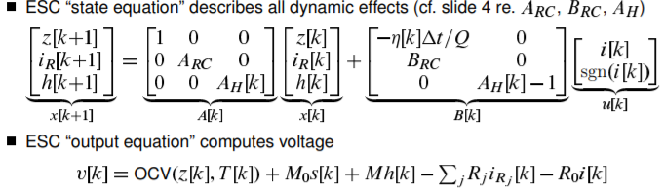
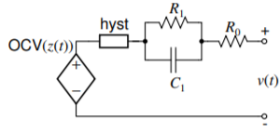
The Enhanced Self-correcting cell model (ECM)
We can now summarize a cell model that combines SOC-dependent open-circuit voltage, Ohmic resistance and diffusion voltages, Hysteresis.
“Enhanced self-correcting” (ESC) cell model does this
Enhanced: Model includes description of hysteresis
Self correcting: Transient behavior imperfect, but steady-state correct Voltage converges to OCV + hysteresis on rest.
Converges to OCV + hysteresis –i(sigmaR) on constant-current event

Slide 11
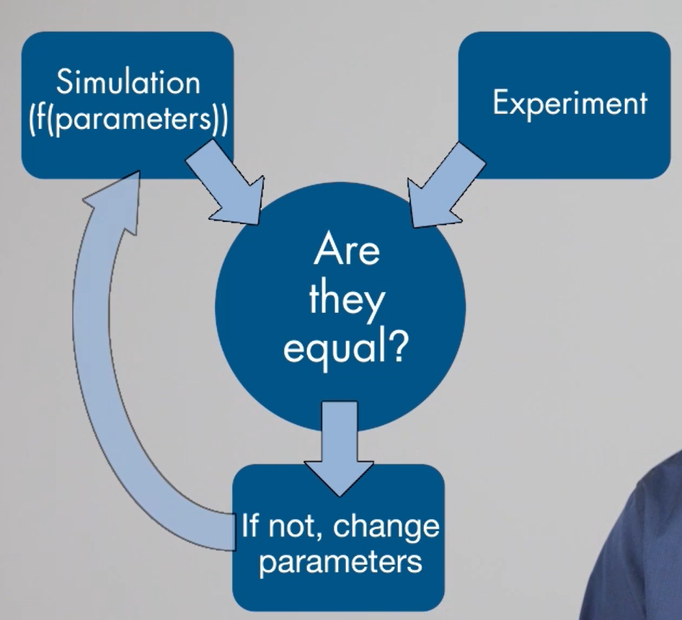
Project Flow-chart (Basic)

Slide 12
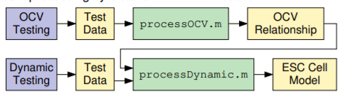
Basic structure of modelling
Purple boxes = laboratory processes, yellow boxes = data files and green boxes = processing by Octave/MATLAB functions.

Slide 13
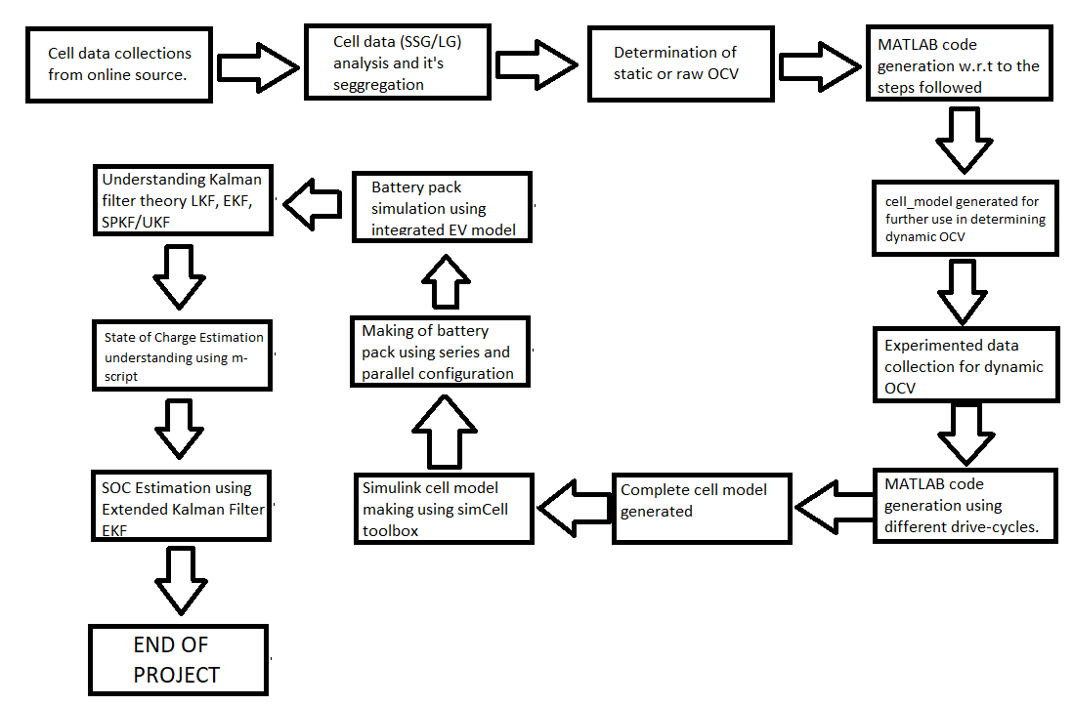

Slide 14
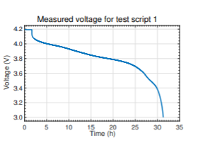
Procedure to measure static OCV of Cell
Discharge portion of test.
OCV test script #1 (at test temperature)
Soak fully charged cell at test temperature for at least two hours to ensure uniform temperature
Discharge cell at constant-current C/30 rate until terminal voltage equals Vmin.
OCV test script #2 (at 25 deg C)
Soak cell at 25 C for at least two hours to ensure uniform temperature throughout
Bring cell terminal voltage to Vmin by dis/charging at C/30 rate.

Slide 15
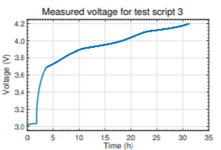
Continuing the procedure
Charge portion of the test.
OCV test script #3 (at test temperature)
Soak cell at test temperature for at least two hours to ensure uniform temperature throughout.
Charge the cell at constant-current rate of C/30 until cell terminal voltage equals Vmax
OCV test script #4 (at 25 deg C)
Soak cell at 25 C for at least two hours to ensure uniform temperature throughout the cell
Bring cell terminal voltage to Vmax by dis/charging at C/30 rate.

Slide 16

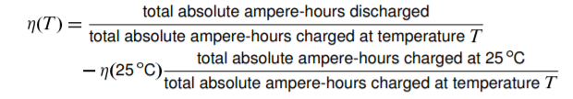
Calculating Coulombic efficiency and total capacity
At 25 deg C
The capacity Q is calculated the total discharge Ah from script1&2 – (eta25)x Total charge Ah from script1&2.
Eta 25 is given by:
At test temperature
The capacity is calculated in the same way i.e., total discharge(Ah) – (eta25)x Total charge Ah (script 2&4)
Eta ~25 is given by:

Slide 17
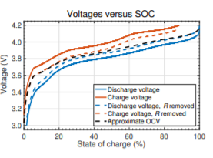
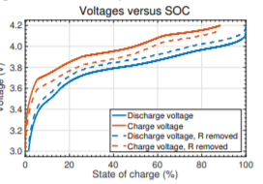
Overcoming missing data
Estimate 100 % SOC discharge resistance via instant voltage change when test moves from step 1 to step 2.
Estimate 0 % SOC resistance via voltage change at end of step 4
Estimate 0 % SOC charge resistance via voltage change when moving from step 5 to 6
Estimate 100 % SOC charge resistance at end of step 8 Assume changes linearly from 0 % SOC value to 100 % SOC value
Approximate mid-SOC steady-state resistance by considering voltage difference between adjusted curves at 50 % SOC
Blend linearly between modified charge-voltage and discharge-voltage curves so that blend is halfway between curves at 50 % SOC
Follows charge curve for low SOC and discharge curve for high SOC. Overcomes “missing data” problem.

Slide 18
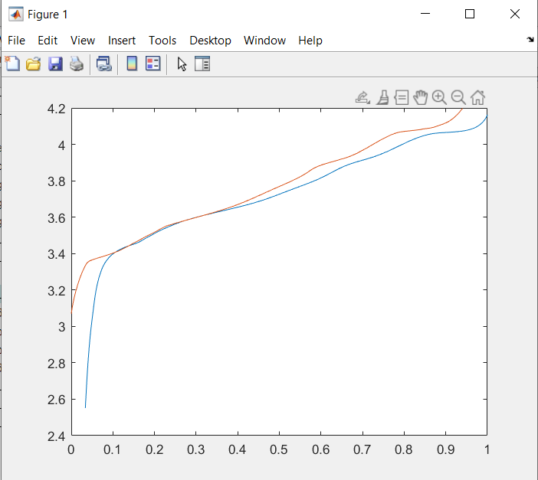
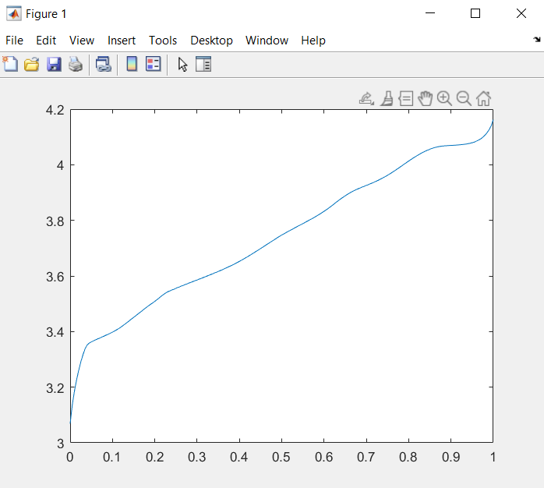
Missing data & overcoming data of SSG cell @ 0 deg C

Slide 19
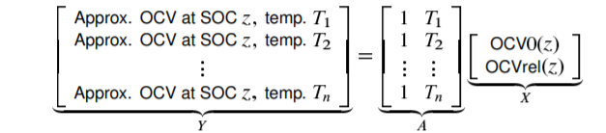
Modelling Temperature dependency
At any given SOC, OCV variation is nearly linear in Combine individual approximate single-temperature OCV results to make a final model of the form.
OCV(z(t),T(t)) = OCV0(z(t)) + T(t) x OCVrel(z(t)) where OCV0(z(t)) is the OCV relationship @0degC, and OCVrel(z(t)) is the linear temperature-correction factor at each SOC.
One way to find X from A and Y is to use the least-squares solution, which is computed in Octave/MATLAB as X=A\Y.
We tend to use data only from tests above 0 C because accuracy degrades at low temperatures due to high cell resistances.

Slide 20
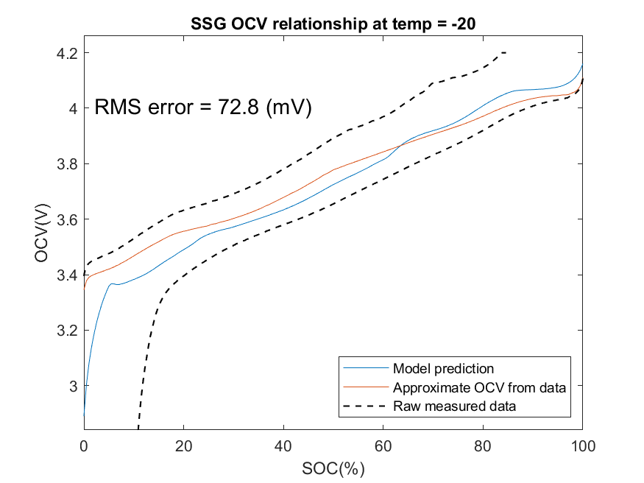
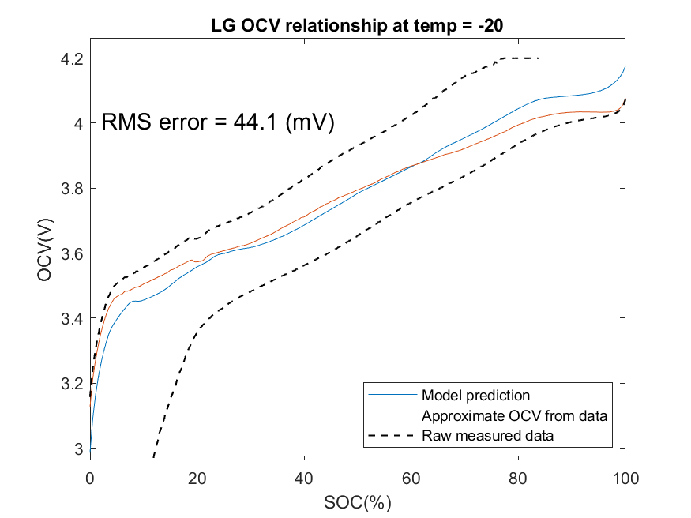
Raw OCV test results

Slide 21
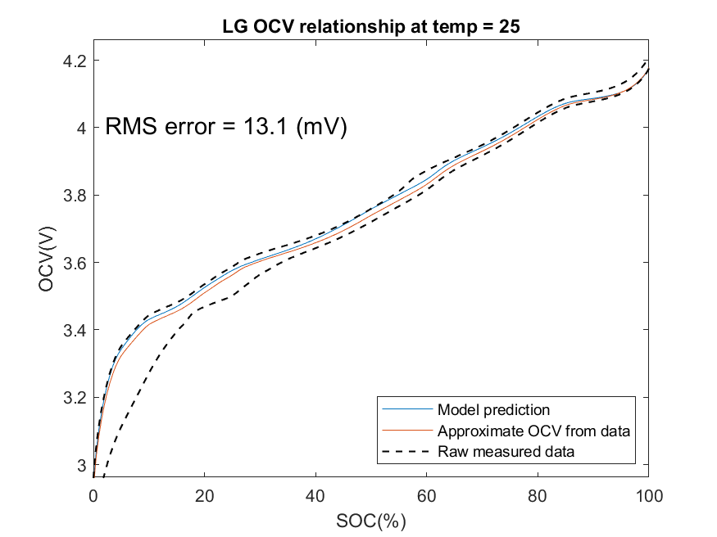
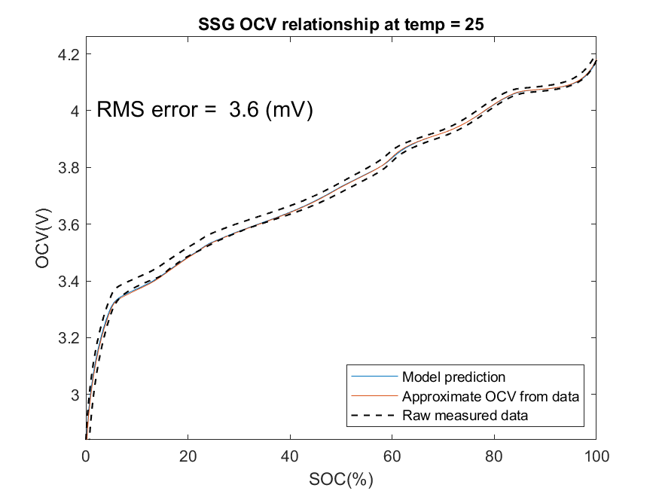
Comparison of LG and SSG cell at 25 deg C

Slide 22
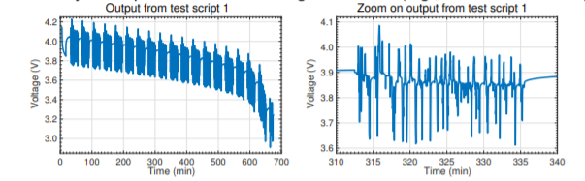
Introducing the dynamic portion of test
Cell must be exercised with demand profile representative of final application to gather data for tuning parameter values of ESC model that describe dynamic effects.
Dynamic “discharge” portion of test
Dynamic test script #1 (at test temperature)
Soak fully charged cell at test temperature for at least two hours to ensure uniform temperature throughout
Discharge cell at constant-current at a C/1 rate for 6 min (avoid over-voltage later)
Execute dynamic profiles over SOC range of interest (e.g., 90 % to 10 % SOC)

Slide 23
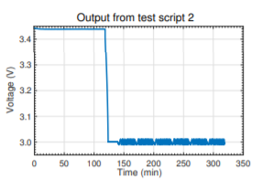
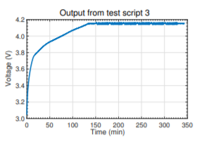
Discharge and charge calibration of the test
Discharge calibration portion of test
Dynamic test script #2 (at 25 C)
Soak cell at 25 C for at least two hours to ensure uniform temperature throughout
Bring cell terminal voltage to Vmin by dis/charging at C/30 rate
Follow-on dither profile(s) can be used to eliminate hysteresis to the greatest degree possible
Charge calibration portion of test
Dynamic test script #3 (at 25 C)
Charge cell using a constant-current C/1 rate (or as specified by manufacturer) until voltage equals Vmax; then, maintain voltage constant at max until current drops below C/30
Follow-on dither profile(s) can be used to eliminate hysteresis to the greatest degree possible

Slide 24
Overall procedure to determine parameter values
First, compute eta and Q from data, directly, as we did for the OCV test results.
Compute z[k], OCV(z[k]) for every data sample; subtract OCV from v[k].
Use subspace system identification technique to find R–C time constants
Compute s[k], i[r] for every data sample
Guess value for gamma for computing hysteresis voltage.
“Unexplained” part of voltage is now linear in parameters—solve for these parameter values using least squares
Compute rms voltage-prediction error of present model
Adapt to minimize this error, iterating steps 5–8 until convergence is reached

Slide 25
Finding R–C time constant
Could use nonlinear optimization to guess and adapt values (together with other unknown parameter values), to minimize rms voltage error.
Nonlinear optimization is slow, not guaranteed to find optimal solution
Subspace system identification replaces nonlinear optimization with linear-algebra technique that finds solution in one step

Slide 26
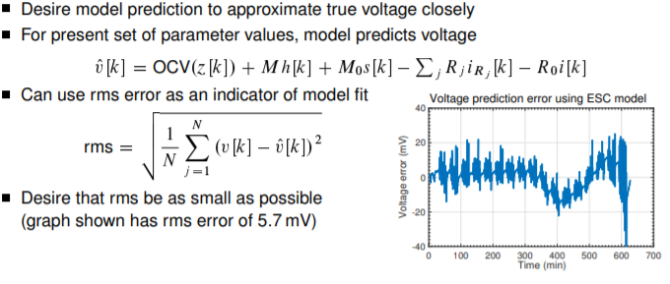
Compute rms prediction voltage error

Slide 27
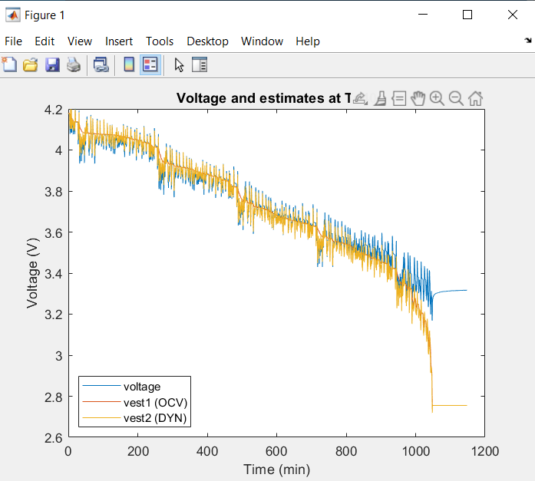
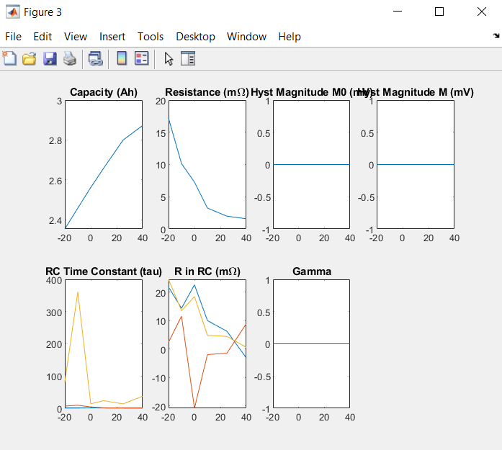
Graphical results for Dynamic OCV
RMS Error = 260mV

Slide 28
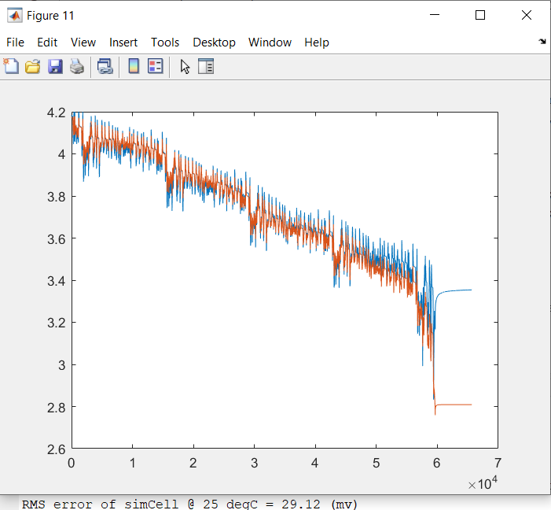
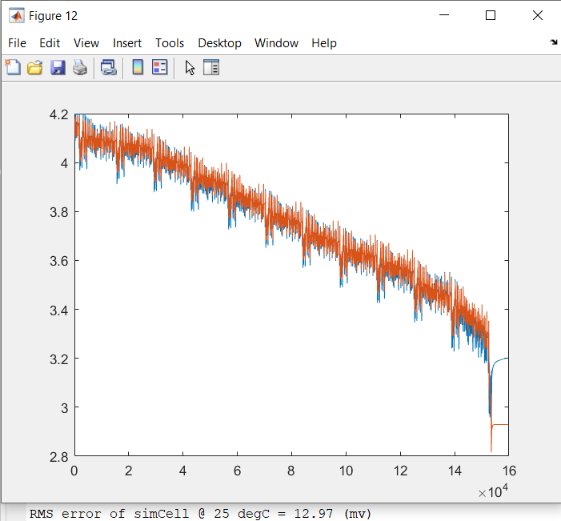
SSG and LG Dynamic model Comparison

Slide 29
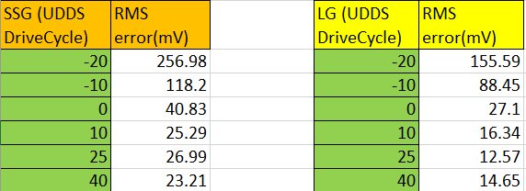
RMS Error comparison Table

Slide 30
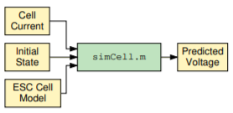
MATLAB toolbox to use the ECM cell model
The figure depicts the process for invoking simCell.m to simulate a cell’s voltage response to an input-current stimulus
Sometimes, it may be important to query model parameters
This may be done by directly accessing fields in “model”
But, this is generally not considered good programming practice Instead, the toolbox provides data accessor functions
In order to determine OCV at one or more SOCs, the OCVfromSOCtemp.m function is used.
In order to determine SOC from one or more at-rest OCVs, the SOCfromOCVtemp.m function is used
Finally, in order to determine a model dynamic parameter value, the getParamESC.m function is used

Slide 31
Simulink cell model using simCell toolbox
sim-Cell file inputs the current, temperature, time and outputs the desired dynamic voltage, actual data voltage and the raw-OCV voltage.
getParamESC function also integrated in the MATLAB function of cell model to call the cell parameter values from the cell-model which was created in dynamicOCV of the required cell, drive-cycle and the cell dynamic data.
With respect to the values loaded in the workspace irkc (RC pair current is calculated in the script and the desried voltage is lastly measured using formula : vk = OCV - RParam*irkc - ik(1).*R0Param
And the voltage error is calculated using : verr=vact-vk

Slide 32
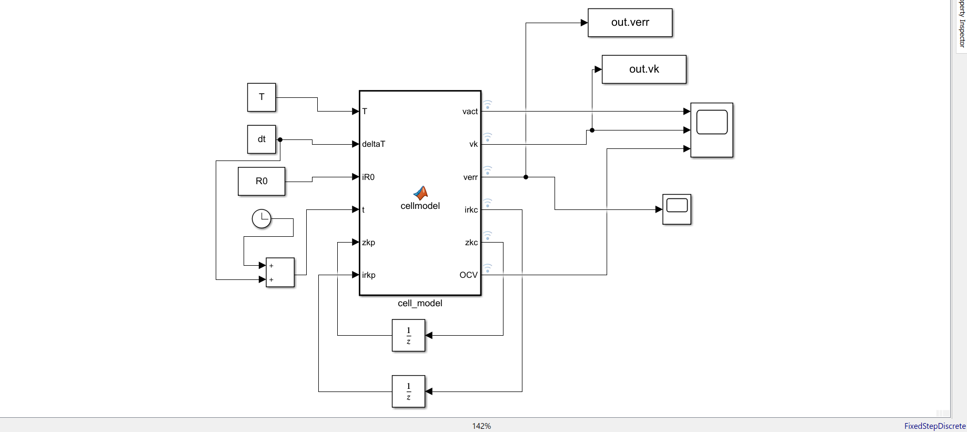

Slide 33
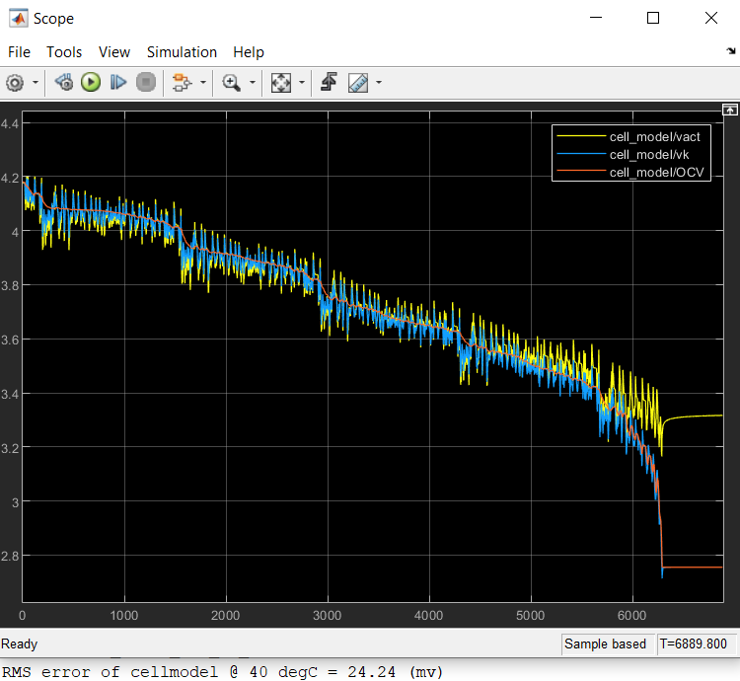
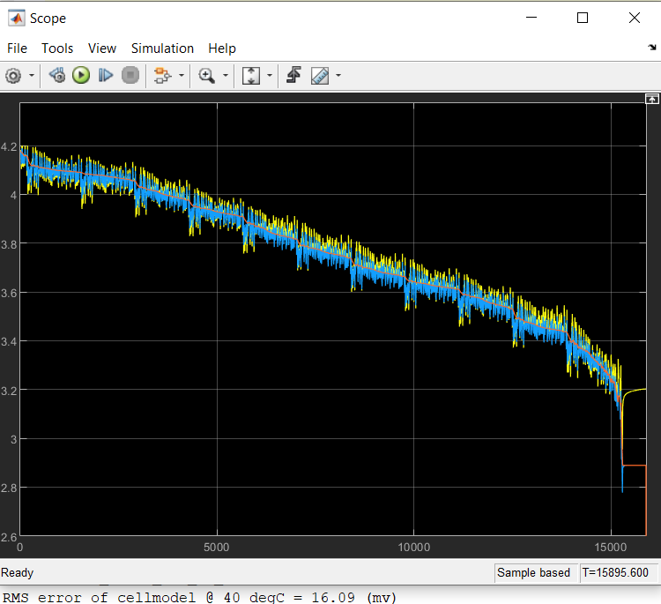
Graphical representation of LG and SSG model at 40 deg C

Slide 34
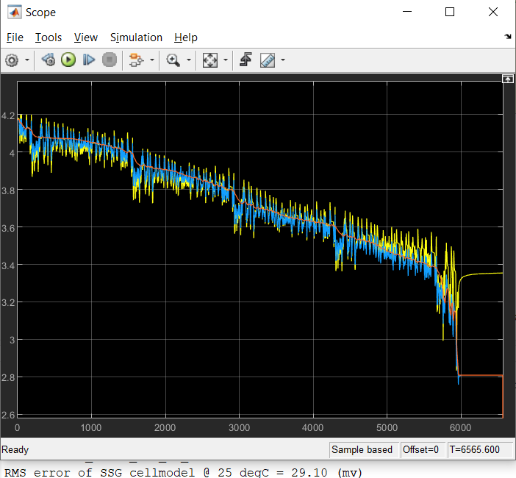
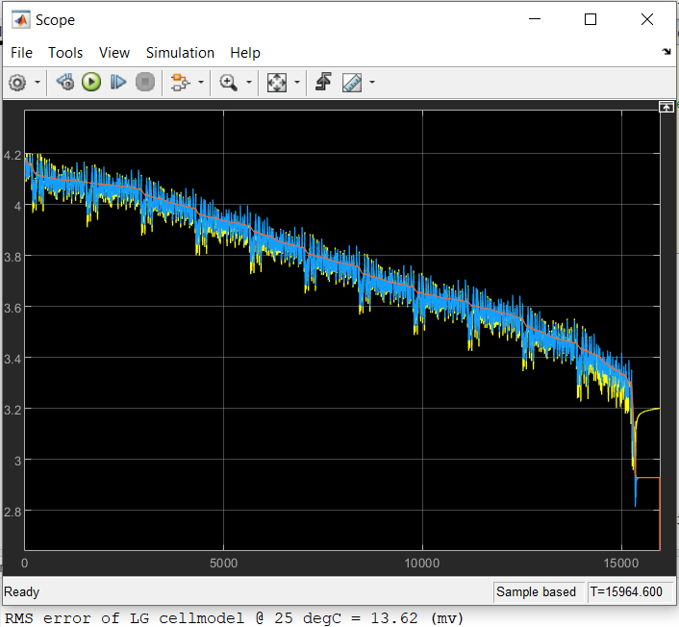
Graphical representation of LG and SSG model at 25 deg C

Slide 35
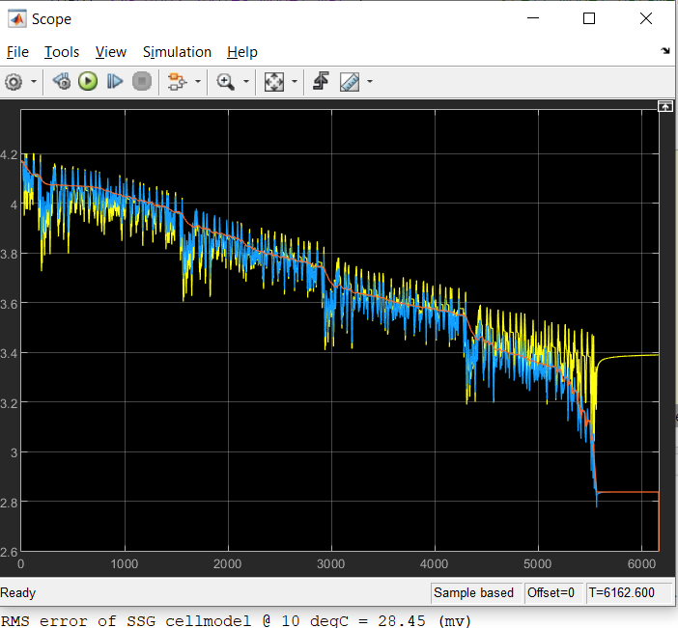
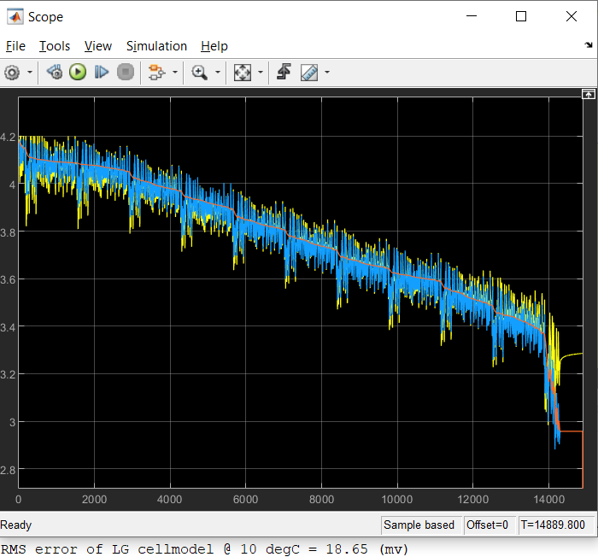
Graphical representation of LG and SSG model at 10 deg C

Slide 36
Battery Pack Sizing
The first step is to figure out the voltage of the battery pack. Thus considering a small LV with voltage = 48V and energy capacity = 7.37kWh. (Considering Mahindra Etreo).
Series cell sum V = Pack voltage/cell voltage = 48/4.2 = 11.42 = 12. So cells in series(n) = 12.
To calculate cells in parallel need to calculate nominal pack capacity = energy capacity(W)/Pack Voltage = 7.37*1000/48 = 154Ah.
m (number of cells in parallel) = Pack capacity/cell capacity = 154/2.8 = 55.
So n*m = 12*55 number of cell needed to power the vehicle.
Taking energy capacity = 1KWh (fast simulation & modelling)
Capacity = 1000*1/48 = 20.834, m = 20.834/2.8 = 7. Therefore n*m = 12*7.

Slide 37
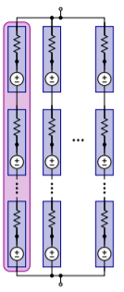
Battery Pack with SCM Configuration
SCM is series cell module i.e. n cells are connected in series to create a single module followed by the connection of each module in parallel.
In current project 12 cells in series making SCM1 as single module therefore total 7 modules (SCM) would be connected in parallel.
Each cell has “fixed” and “variable” parts. All “fixed” parts sum to equivalent voltage source; “variable” parts sum to equivalent resistance: SCM collapses to “cell”.
If lumped voltage of SCM is vj,k and total resistance is R0,j bus voltage is V = (sum(sum(v,1)./sum(r0,1),2)-I)./sum(1./sum(r0,1),2);
And the module SCM currents is given by : ik = (sum(v,1)-repmat(V,1,Np))./sum(r0,1);

Slide 38
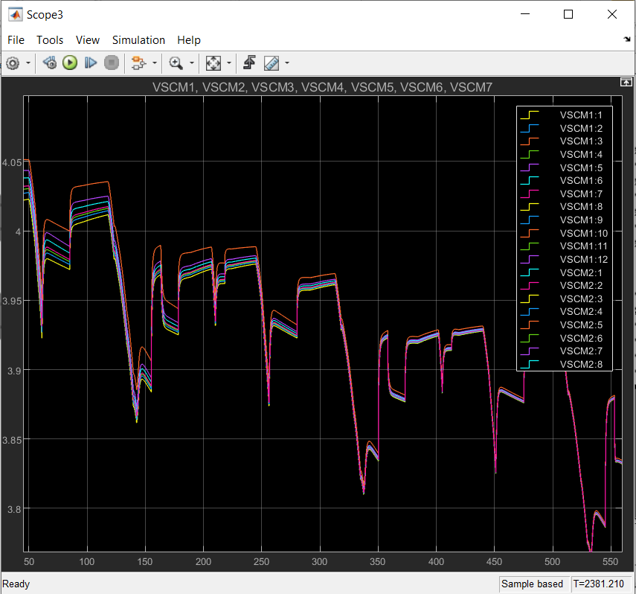
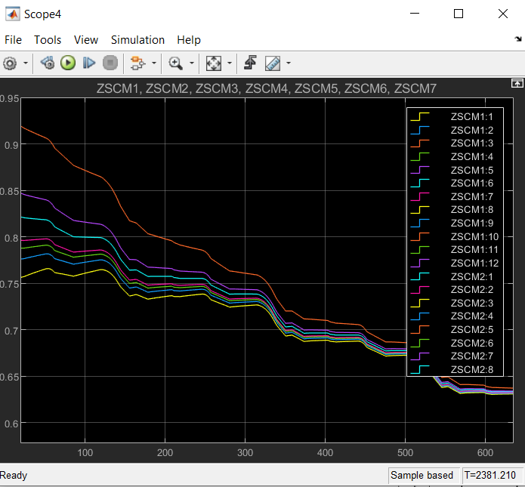
Graphical representation of SCM voltage and SOC of cell

Slide 39
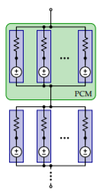
Battery Pack with PCM Configuration
PCM is Parallel cell module i.e., m cells are connected in parallel to create a single module followed by connection of each modules in series.
In current project 7 number of cells will be connected in parallel making PCM1 as a single module therefore total 12 SCM will be connected in series configuration.
Consider PCM, recalling that cell voltage comprises a “fixed” part that does not depend on present cell current, and “variable” part that does depend on present cell current.
Can model cells in parallel as drawn, where voltage source in each branch is fixed part, and resistor current is variable part.
By KVL the voltage is given by V = (sum(v./r0,2) - I)./sum(1./r0,2);
By KCL the current is given by ik = (v-repmat(V,1,Np))./r0;

Slide 40
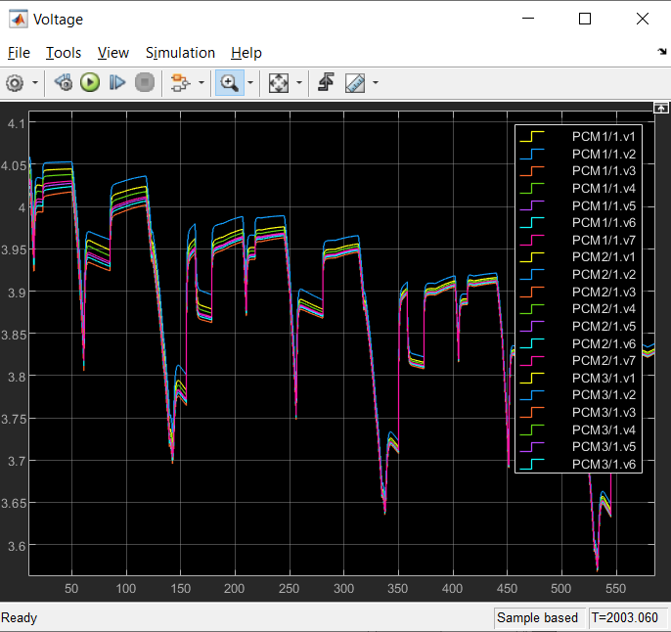
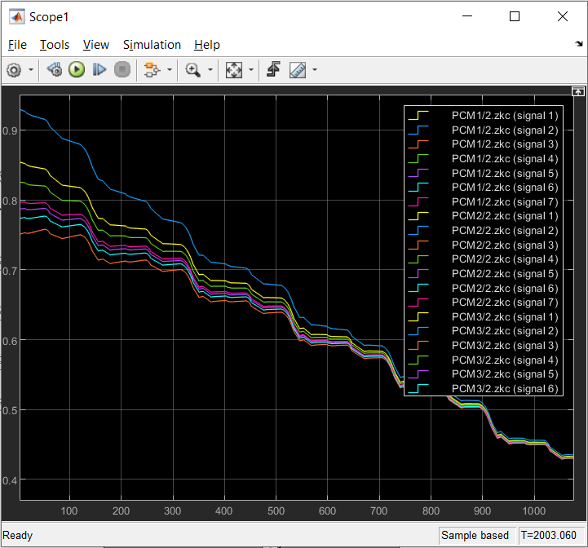
Graphical representation of PCM voltage and SOC of cell

Slide 41
SOC Estimation using Kalman Filter
Kalman filters are often used to optimally estimate the internal states of a system in the presence of uncertain and indirect measurements. When the state of a system can only be measured indirectly, you can use a Kalman filter to optimally estimate the states of that system.
And when measurements from different sensors are available but subject to noise, you can use a Kalman filter to combine sensory data from various sources (known as sensor fusion) to find the best estimate of the parameter of interest.

Slide 42
State, Parameter and Pros of SOC Estimation
A BMS must be able to estimate two fundamentally different types of non-measurable battery-pack quantity.
States change quickly (e.g., state-of-charge, diffusion voltage, hysteresis voltage)
Parameters change slowly (e.g., cell capacities, resistances, aging effects)
Benefits of SOC Estimations
Longevity : Over-charging and over-discharging may cause permanent damage. Thus, good estimator will avoid this phenomena.
Performance : With a good estimate, especially one with known error bounds, one can aggressively use the entire pack capacity.
Reliability : Poor estimators behave differently. A good SOC estimator is consistent and dependable for any driving profile, enhancing overall power-system reliability

Slide 43


Extended Kalman Filter steps
The EKF generally uses Taylor’s series expansion to convert non linear system to linear.
There are total 6 steps used in the EKF the first three are for prediction and the remaining three are about updating the prediction equations or correction steps.
KF assumes a cell model of the form:
But, cell models are nonlinear, so the standard KF recursion doesn’t apply directly. We now generalize to the nonlinear case, with system dynamics describe as:

Slide 44

Steps used in EKF (Prediction Steps)
Step 1a: State prediction time update
That is, we approximate the expected value of the new state by assuming that it is reasonable to simply propagate prior state prediction and prior process noise through the state equation.
Ahat and Bhat is the differentiation of the state equation and process noise equation respectively. (From Taylor’s series)

Slide 45
Steps used in EKF (Prediction Steps)
Step 1b: Error co-variance time update
Equation used for the above is:
Step 1C: Output estimate indeed finding the measurement equation time update
yhat = OCVfromSOCtemp(xhat(zkInd),Tk,model) + M0*signIk + ...
M*xhat(hkInd) - R'*xhat(irInd1) - R0*ik;

Slide 46



Steps used in EKF (Correction Steps)
Step 2a: Estimator gain matrix (Lk)
Gain matrix (Lk) is time varying it adapts to give the best time update to the state estimate based on present conditions.
Step 2b: State estimate measurement update
Computes posterior state estimate by updating prediction using estimator gain and innovation
Step2c: Error covariance measurement update.
Finally, the updated covariance is computed as:

Slide 47
SOC Estimation using Project Cell Model
The EKF code is have three routines, first the initialization routine invoked once at start.
Second iterationEKF function And this is executed one time every sample interval.
So that is, every time we take a measurement of voltage, and current, and temperature, we pass those measurement values to this function.
And it performs one execution of these six substeps of the EKF to update the state estimate and its covariance.
The third and final segment of code called wrapper code.
So it coordinates the start up of the algorithms.
And it makes the measurements and it executes all the different algorithms at the appropriate times.

Slide 48
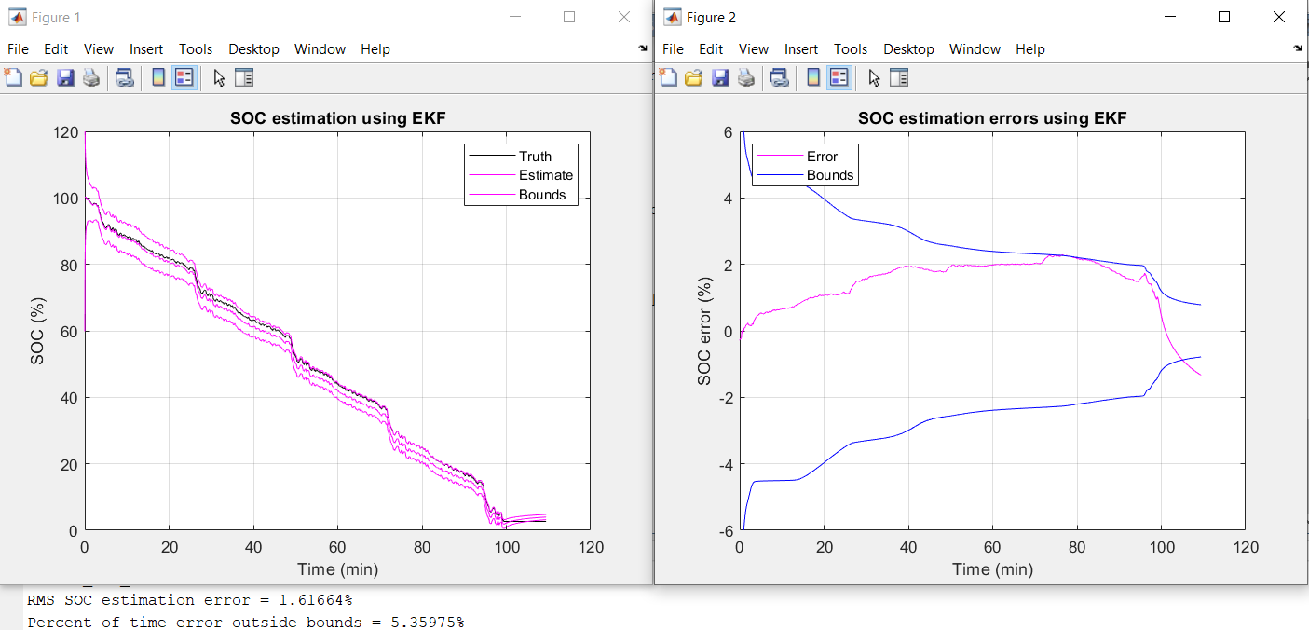
SOC Estimation using wrapper code
For 2 RC Pair and at 25 Deg C

Slide 49
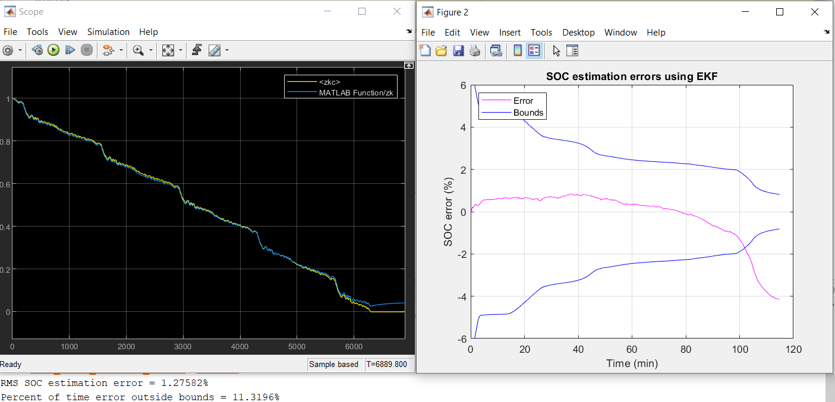
SOC Estimation using Simulink model and it’s data
With 3 RC pairs and at 40 C

